Slide 1
Cyber Laws and Forensics
ANA19190815 JSK
Marks 8

Slide 2
Cyber crime
Cybercrime is defined as an unlawful action against any person using a computer, its systems, and its online or offline applications. It occurs when information technology is used to commit or cover an offense. However, the act is only considered Cybercrime if it is intentional and not accidental
Example
The fraud did by manipulating computer network
Unauthorized access to or modification of data or application
Intellectual property theft that includes software piracy
Industrial spying and access to or theft of computer materials
Writing or spreading computer viruses or malware
Digitally distributing child pornography

Slide 3
Cybercrime Attack Types
Hacking: It is an act of gaining unauthorized access to a computer system or network
Denial Of Service Attack: In this cyber attack, the cyber-criminal uses the bandwidth of the victim’s network or fills their e-mail box with spammy mail. Here, the intention is to disrupt their regular services
Software Piracy: Theft of software by illegally copying genuine programs or counterfeiting. It also includes the distribution of products intended to pass for the original
Phishing: Pishing is a technique of extracting confidential information from the bank/financial institutional account holders by illegal ways.
Spoofing: It is an act of getting one computer system or a network to pretend to have the identity of another computer. It is mostly used to get access to exclusive privileges enjoyed by that network or computer.

Slide 4
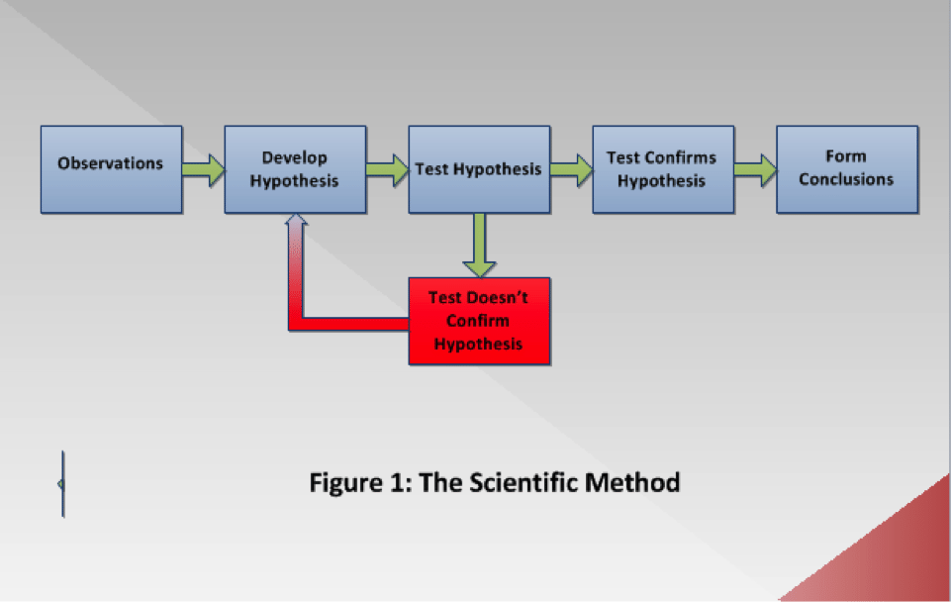
What is Cyber forensics ?
Process of using scientific knowledge for collecting ,analysing and presenting evidences to the court

Slide 5
Observations: The first stage, typically known in computer forensics as the examination phase, involves information gathering through making observations of the evidence. In this phase, the forensic scientists verify the authenticity and integrity of proof. They also perform data carving (a forensic technique of reassembling files from raw data fragments when no file system metadata is available), and keyword searching, among other activities.
Develop Hypothesis: In this second phase, the forensic professionals develop one or more hypotheses based on the observations that they have made in the first phase. When forming a hypothesis, the forensic practitioners try to determine what incident happened, when it happened, where it happened, why it happened, and how it happened.
Test Hypothesis: This phase involves the test of the hypothesis that has been developed.

Slide 6
Test Confirms Hypothesis: The result must be verified to prove or disprove the hypothesis. The case cannot be established unless the hypothesis is varied. This is a cyclic process and, therefore, requires the forensic scientists to repeat it unless the hypothesis is verified, as shown in Figure 1.
Form Conclusions: Once the test is verified, the forensic practitioners can form the correct conclusion based on the verified test.
Computer forensics examinations differ from one another based on the data being investigated, the objectives of the examination, and the resources available. However, when the scientific method is applied to a computer forensics investigation, the underlying fundamental process remains the same.
The Principle of Reproducibility: This is a basic principle of the scientific method whereby another forensic expert following precisely the same steps should form the same conclusion.

Slide 7
Locard’s Exchange Principle
Locard firmly believed that no matter what a criminal does or where a criminal goes, he/she will certainly leave trace evidence at the crime scene
In fact, whenever two or more people come into contact with one another, a physical transfer takes place. Skin, hair, pollen, clothing fiber, glass fragments, makeup, debris from clothing, or any other material can be transferred from one person to another. This material helps the forensic examiners to collect the trace evidence

Slide 8
The applicability of Locard’s Principle of Transference in computer forensics
applies to cybercrimes involving computer networks, such as identity thefts and electronic bank frauds.
To establish an internet connection, the computer must have a network interface card (NIC). Once the connection is successfully established, the NIC transmits its MAC address to a relevant DHCP server. After that, the DHCP server logs record this MAC address and assign an IP address to the computer, which would receive and store this IP address. Noticeably, the interaction between computer and DHCP server causes the exchange of information, such as MAC and IP addresses, between both devices.
This interaction can help the forensic experts to determine the specified date and time of the day when this interaction took place.

Slide 9
The Inman-Rudin Paradigm
This paradigm, in fact, expanded the Locard’s Exchange Principle into two principles and four processes that were applicable not only in physical forensics but also in computer forensics.
The principles are:
Transfer: The transfer, in fact, is Locard’s Exchange Principle, the exchange of material between two persons.
The divisibility of matter: This represents the ability to impute the characteristics to the whole of something from a separate piece of it.

Slide 10
Four processes:
Identification defines the physico-chemical nature of the evidence; for example, the number of heads, cylinders, and sectors of the hard drive.
Classification/Individualization—Classification attempts to determine the source, whereas the individualization employs some characteristics to uniquely identify a specimen. For example, a security camera captured the crime scene and showed an unidentified perpetrator who killed the victim. On the other hand, the image was clear enough to recognize his gun. The investigators examined the bullet recovered from the victim corpse and found the gun manufacturer, based on bullet’s composition, size, and weight. In fact, these are all class characteristics.
Association
Construction

Slide 11
Elements of the crime
LAW
There must be some law that was broken
Unethical but not criminal
Intent
Burden of Proof
Depending on case burden of proof might be different
Exculpatory Evidence

Slide 12
Cyberstalking is when a cybercriminal uses email, direct messaging, or other electronic means to harass, scare, or threaten someone with physical harm. It takes different forms, including:
Tracking someone’s online activity or physical location
Stealing someone’s identity for financial gain
Making death threats or other overt threats of violence
Blackmailing a victim using personal information or photos
Making false accusations about a victim online
Doxxing a victim by publishing their private information online
Destroying or manipulating incriminating data by sending a virus to a victim’s devices
Posting derogatory statements about a victim publicly
Posing as a victim online to cause harm to their life or career
Sending threatening doctored photos or deepfakes of the victim or their family

Slide 13
What is Phishing? Phishing is a social engineering tactic that consists of an attacker sending an employee a fraudulent message via email, instant message or text message, in the hope that the unaware employee will click a link that downloads malware onto their system, freezes the system as part of a ransomware attack or reveals sensitive information of the organization.

